Slide 1
HTML5
Web Application Course
Instructor: Osama Alkhoun

Slide 2
HTML5
Chapter 02

Slide 3
HTML Headings
Headings are important in HTML documents.
Headings are defined with the <h1> to <h6> tags.
<h1> defines the most important heading. <h6> defines the least important heading.

Slide 4
Headings Are Important
Search engines use the headings to index the structure and content of your web pages.
Users skim your pages by its headings. It is important to use headings to show the document structure.
<h1> headings should be used for main headings, followed by <h2> headings, then the less important <h3>, and so on.

Slide 5
HTML Horizontal Rules
The <hr> tag defines a thematic break in an HTML page, and is most often displayed as a horizontal rule.
The <hr> element is used to separate content (or define a change) in an HTML page:

Slide 6
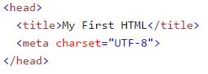
The HTML <head> Element
The HTML <head> element has nothing to do with HTML headings.
The <head> element is a container for metadata. HTML metadata is data about the HTML document. Metadata is not displayed.
The <head> element is placed between the <html> tag and the <body> tag:

Slide 7

HTML Paragraphs
The HTML <p> element defines a paragraph:

Slide 8
HTML Display
You cannot be sure how HTML will be displayed.
Large or small screens, and resized windows will create different results.
With HTML, you cannot change the output by adding extra spaces or extra lines in your HTML code.
The browser will remove any extra spaces and extra lines when the page is displayed:

Slide 9
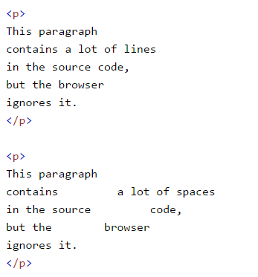
HTML Display example

Slide 10
Don't Forget the End Tag
Most browsers will display HTML correctly even if you forget the end tag:
<p>This is a paragraph. <p>This is another paragraph.

Slide 11
HTML Line Breaks
The HTML <br> element defines a line break.
Use <br> if you want a line break (a new line) without starting a new paragraph:
<p>This is<br>a paragraph<br>with line breaks.</p>
The <br> tag is an empty tag, which means that it has no end tag.

Slide 12
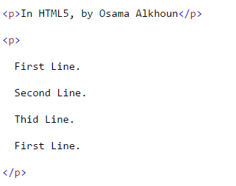
The Poem Problem
This poem will display on a single line:

Slide 13
The HTML <pre> Element
The HTML <pre> element defines preformatted text.
The text inside a <pre> element is displayed in a fixed-width font (usually Courier), and it preserves both spaces and line breaks:

Slide 14
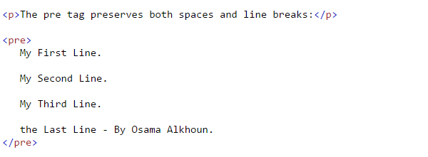
The HTML <pre> Element

Slide 15
HTML Tag Reference
Tag | Description
<p> | Defines a paragraph
<br> | Inserts a single line break
<pre> | Defines pre-formatted text

